Slide 1

2. Relational Model
Introduction to Information Systems

Slide 2
Section A
Recap and Preview

Slide 3
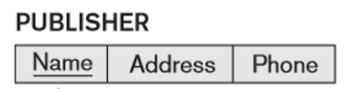
Section A – Recap and Review
Primary Key
Foreign Key
Non-Primary Key Attribute

Slide 4
Section A – Recap and Review
Primary Key
Foreign Key
Non-Primary Key Attribute

Slide 5
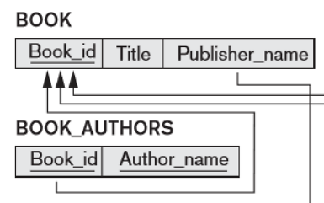
Section A – Recap and Review
Primary Key
Foreign Key
Non-Primary Key Attribute

Slide 6
Section A – Recap and Review
Primary Key
Foreign Key
Non-Primary Key Attribute

Slide 7
Section A – Recap and Review
Primary Key
Foreign Key
Non-Primary Key Attribute
“BOOK_AUTHORS.Book_id references BOOK.Book_id”

Slide 8
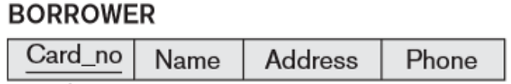
Section A – Recap and Review
Primary Key
Foreign Key
Non-Primary Key Attribute

Slide 9
Section A – Recap and Review
Primary Key
Foreign Key
Non-Primary Key Attribute

Slide 10
Section B
Integrity Constraints

Slide 11
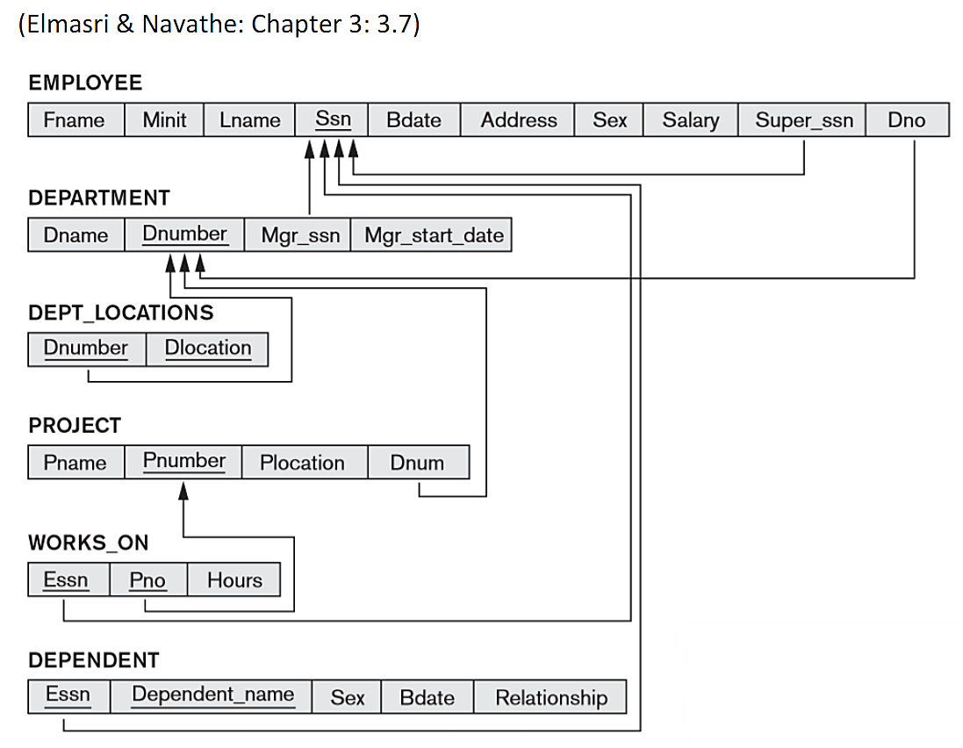
Section B – Integrity Constraints
An employee’s salary cannot be higher than that of their supervisor
Departments cannot have more than three active projects at a time

Slide 12
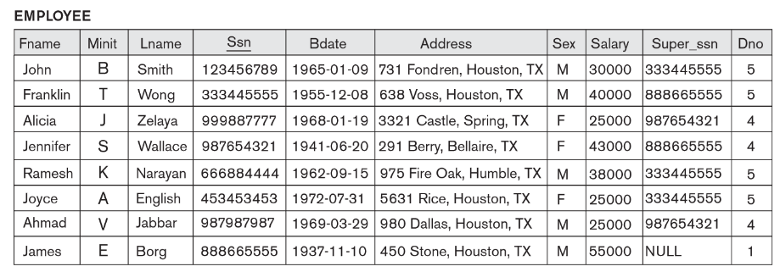
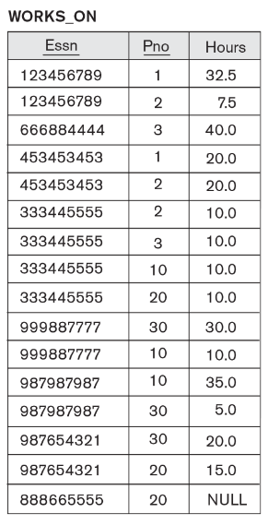
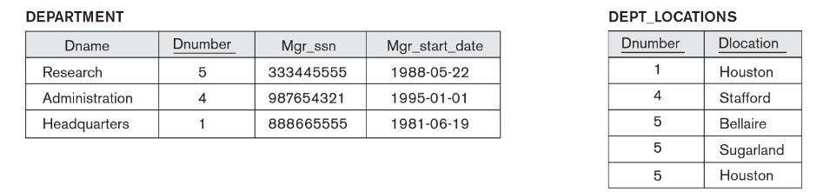
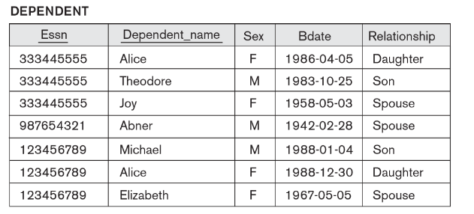
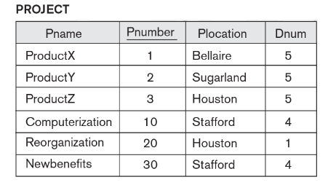
Section B

Slide 13
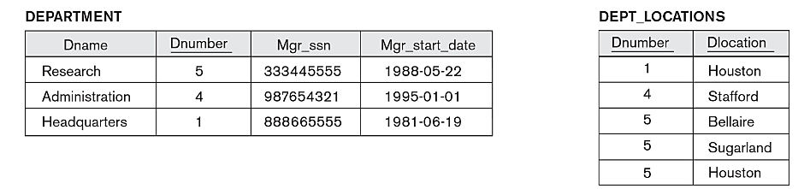
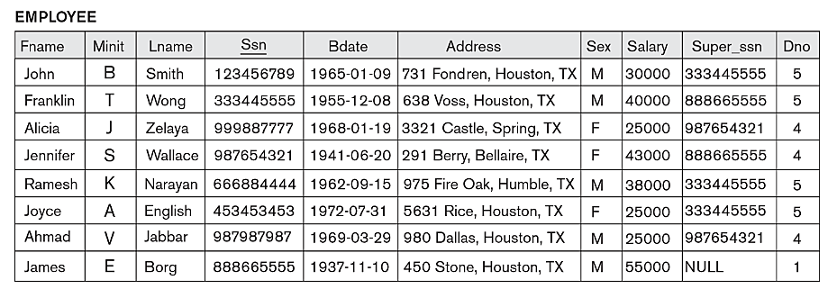
Section B
B1
Insert ('Robert', 'F', 'Scott', 943775543, ‘1942-06-21', '2365 Newcastle Rd, Bellaire, TX', ‘M’, 50000, 888665555, 1) into EMPLOYEE
An employee’s salary cannot be higher than that of their supervisor

Slide 14
Section B
B1
Insert ('Robert', 'F', 'Scott', 943775543, ’1942-06-21', '2365 Newcastle Rd, Bellaire, TX', ‘M’, 50000, 888665555, 1) into EMPLOYEE
Constraint Violations:
Domain: N/A
Entity: N/A Key: N/A Referential: N/A
Semantic: N/A
Robert | F | Scott | 943775543 | 1942-06-21 | 2365 Newcastle Rd, Bellaire, TX | M | 50000 | 888665555 | 1
50,000 < 55,000

Slide 15
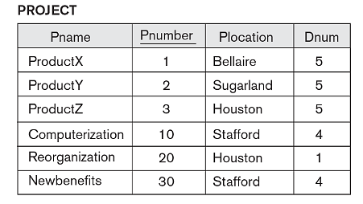
Section B
B2
Insert ('ProductA’, ‘A’, 'Bellaire', 2) into PROJECT
B2

Slide 16
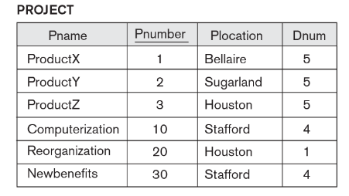
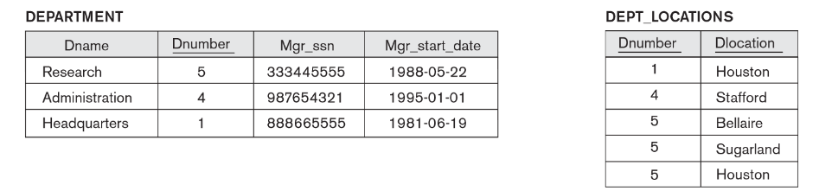
Section B
B2
Insert ('ProductA’, ‘A’, 'Bellaire', 2) into PROJECT
Violations:
Domain: ‘A’ is not an integer
Entity: N/A Key: N/A Referential: DNUM = 2 ?
Semantic: N/A
ProductA | 4 | Bellaire | 2

Slide 17
Section B
B3
Insert ('Production', 4, 943775543, ‘1988-10-01') into DEPARTMENT

Slide 18
Section B
B3
Insert ('Production', 4, 943775543, ‘1988-10-01') into DEPARTMENT
Violations:
Domain: N/A
Entity: N/A Key: DNUMBER 4 already exists Referential: MGRSSN = 943775543 ?
Semantic: N/A
Production | 4 | 943775543 | 1988-10-01

Slide 19
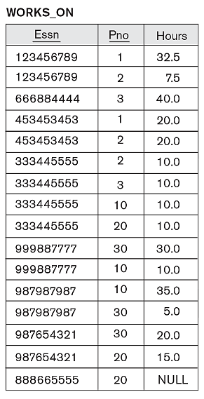
Section B
B4
Insert (677678989, NULL, 40.0) into WORKS_ON

Slide 20
Section B
B4
Insert (677678989, NULL, 40.0) into WORKS_ON
Violations:
Domain: N/A
Entity: Part of the primary key is null Key: N/A Referential: ESSN = '677678989' ?
Semantic: N/A
677678989 | NULL | 40.0
40.0 > 5.0

Slide 21
Section B
B5
Insert ('Grace', 'G', 'Chan', 031203126, ‘1962-06-21', '2312 Anchor Rd, Bellaire, TX', ‘F’, 58000, 888665555, 1) into EMPLOYEE.
An employee’s salary cannot be higher than that of their supervisor

Slide 22
Section B
B5
Insert ('Grace', 'G', 'Chan', 031203126, ‘1962-06-21', '2312 Anchor Rd, Bellaire, TX', ‘F’, 58000, 888665555, 1) into EMPLOYEE.
Violations:
Domain: N/A
Entity: N/A Key: N/A Referential: N/A
Semantic: Supervisors salary is $55,000 ?
Grace | G | Chan | 031203126 | 1962-06-21 | 2312 Anchor Rd, Bellaire, TX | F | 58000 | 888665555 | 1
58,000 > 55,000

Slide 23
Section B
B6
Delete the WORKS_ON tuples with ESSN = 333445555

Slide 24
Section B
B6
Delete the WORKS_ON tuples with ESSN = 333445555
Violations:
Domain: N/A
Entity: N/A Key: N/A Referential: N/A
Semantic: N/A

Slide 25

Section B
B7
Delete the EMPLOYEE tuple with SSN = 9876543321

Slide 26
Section B
B7
Delete the EMPLOYEE tuple with SSN = 9876543321
Violations:
Domain: N/A
Entity: N/A Key: N/A Referential: Other tuples ref. '987654321’
Semantic: N/A

Slide 27
Section B
B8
Modify the MGRSSN and MGRSTARTDATE of the DEPARTMENT tuple with DNUMBER = 5 to 123456789 and ‘1988-10-01’ respectively

Slide 28
Section B
B8
Modify the MGRSSN and MGRSTARTDATE of the DEPARTMENT tuple with DNUMBER = 5 to 123456789 and ‘1988-10-01’ respectively
Violations:
Domain: N/A
Entity: N/A Key: N/A Referential: N/A
Semantic: N/A
123456789
1988-10-01

Slide 29
Section B
B9
Modify the SUPERSSN attribute of the EMPLOYEE tuple with SSN = 999887777 to 943775543

Slide 30
Section B
B9
Modify the SUPERSSN attribute of the EMPLOYEE tuple with SSN = 999887777 to 943775543
Violations:
Domain: N/A
Entity: N/A Key: N/A Referential: Tuple for '943775543’ ?
Semantic: N/A
943775543

Slide 31
Section B
B10
Insert ('ProductSuperDuperSecret', 86, 'Washington', 5) into PROJECT
Departments cannot have more than three active projects at a time

Slide 32
Section B
B10
Insert ('ProductSuperDuperSecret', 86, 'Washington', 5) into PROJECT
Violations:
Domain: N/A
Entity: N/A Key: N/A Referential: N/A
Semantic: The department “Research” already has 3 projects ?
ProductSuperDuperSecret | 86 | Washington | 5
4 > 3

Slide 33
Questions?

